Slide 1
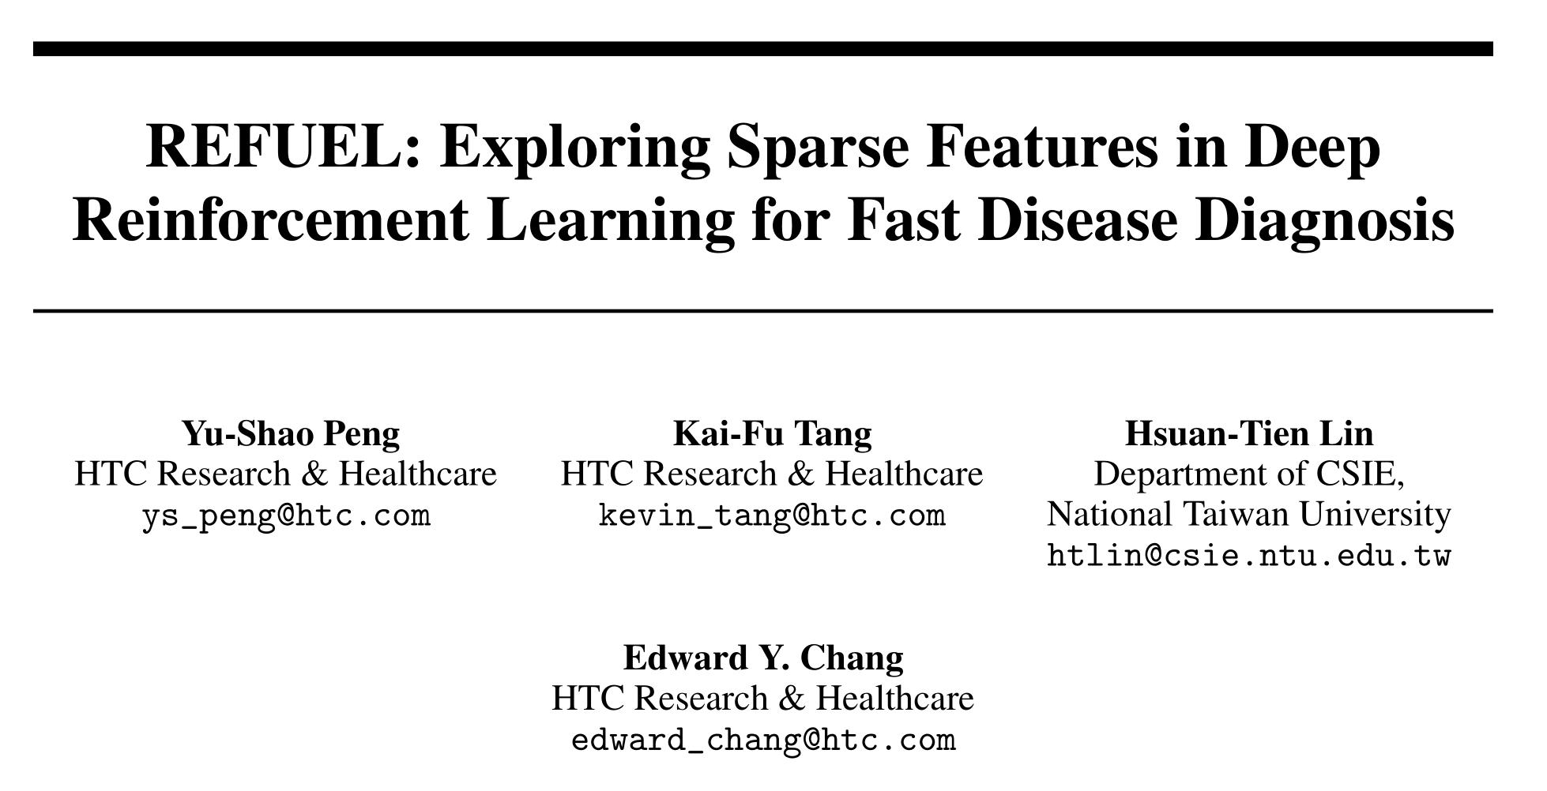
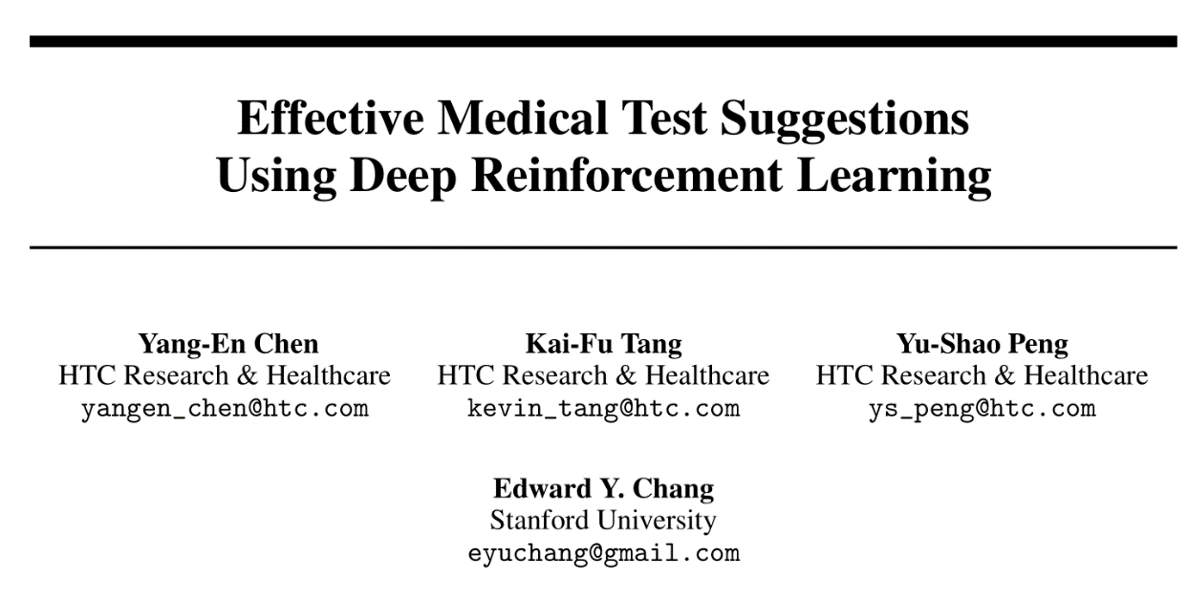
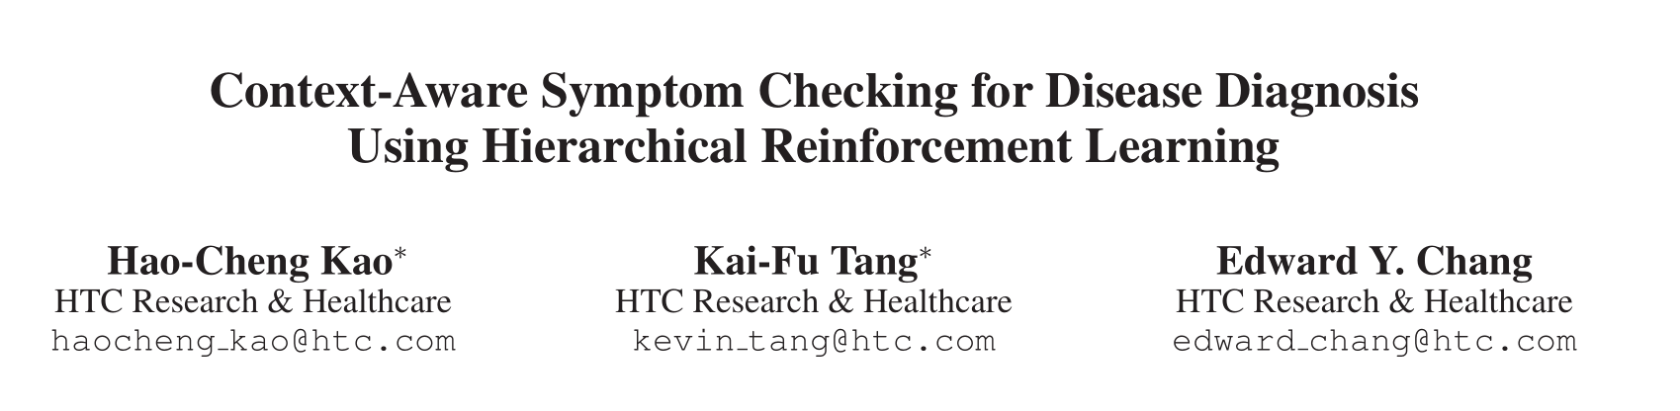
Introduction

Slide 2


State representation
· Context-Aware Symptom Checking
symptom + context information (age, gender, season)
· REFUEL: Only symptom .
symptom + context information (age, gender, season)
· Effective Medical Test Suggestions:
symptom + medical test (normal?) + disease

Slide 3
Action
· Context-Aware Symptom Checking
Master: choose a model / predict a disease
· REFUEL: symptom + disease in one layer.
· Effective Medical Test Suggestions:
Symptom(q1,q2) → medical test → disease prediction

Slide 4
Reward
· Context-Aware Symptom Checking
Punish the repeated inquiry/wrong prediction
· REFUEL: Reward for correct predict + symptom (reward shaping)
Punish the wrong predict + more than the maximum length + useless predict(reward shaping).
· Effective Medical Test Suggestions:
Encourage the right prediction + present symptoms + abnormal test
Punish the medical test cost + too many queries + wrong prediction (without reward shaping)
Encourage the right prediction

Slide 5
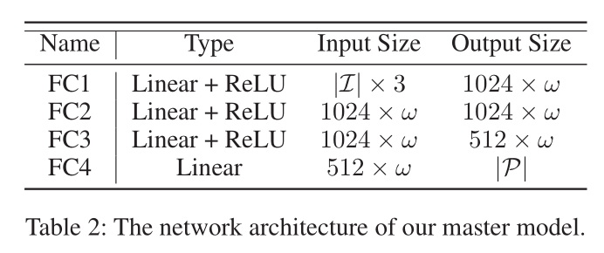
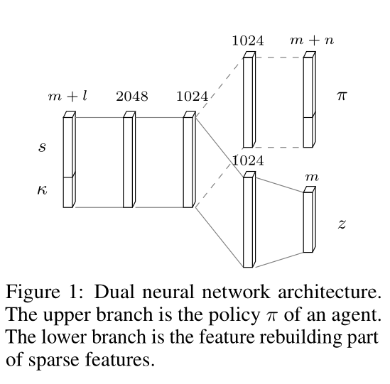
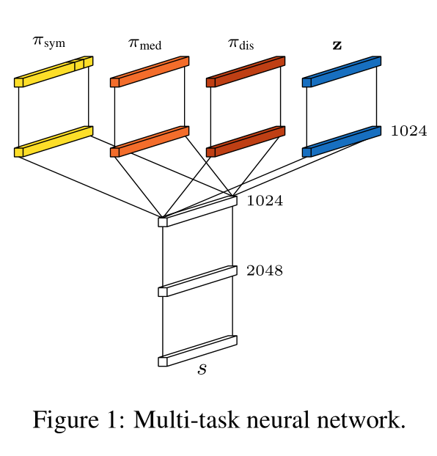
Network
· Context-Aware Symptom Checking
· REFUEL: Q-Learning + Rebuild + discounted reward
· Effective Medical Test Suggestions:

Slide 6
Contribution
· Context-Aware Symptom Checking
New model (HRL) + new information (context)
· REFUEL:
New trick (reward shaping + feature rebuild ----- correlation between symptom)
· Effective Medical Test Suggestions:
Feature rebuild + new information(medical test)

Slide 7
Discussion
· 为什么在最开始的文章中作者采用了HRL，然后后面两个版本似乎又弃用了这个结构（我觉得这个结构挺符合常识的）
· 按时间线来看似乎学长的文章是在第一版上把disease classification的位置做了一个改动，然后reward shaping也是一个
已有的结构，也没有往网络里面添加新的信息（context information也没有了）

